Slide 1
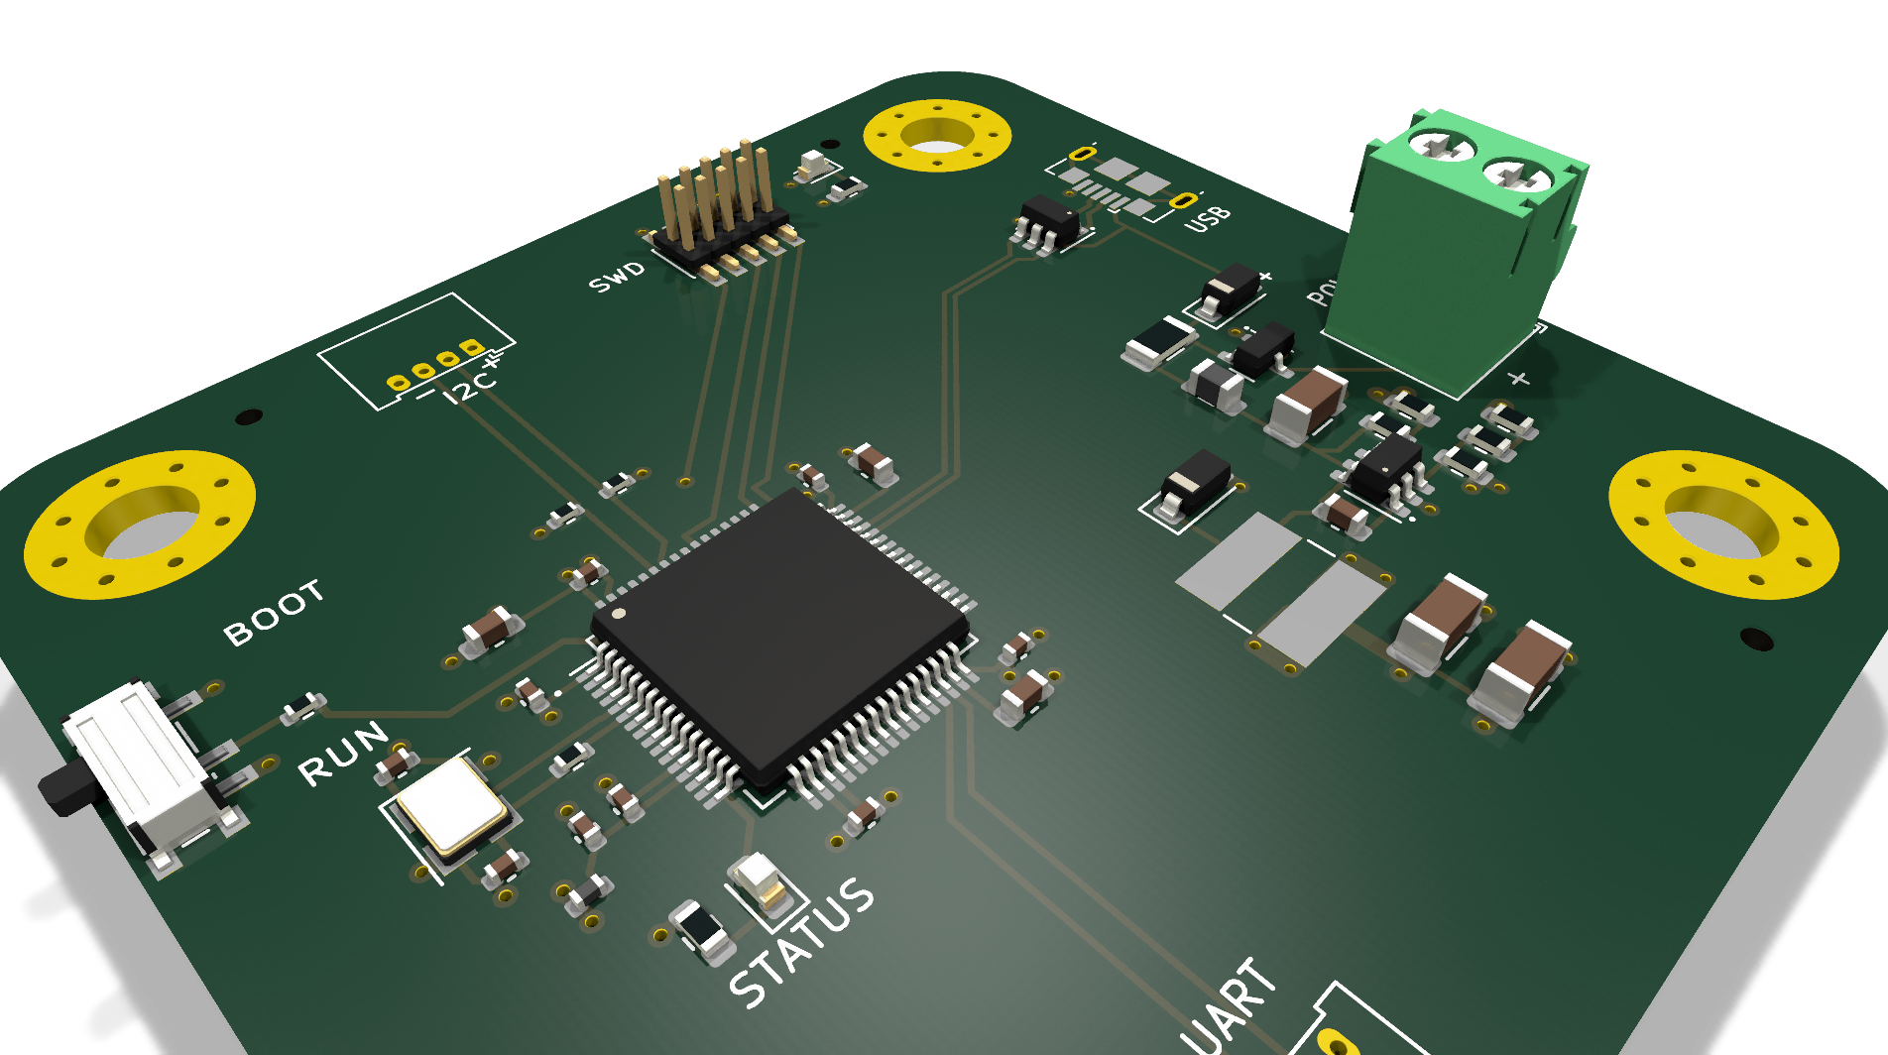
ELECTRONICS MANUFACTURING & PCB DESIGN (EMP) · COURSE PROJECT
STM32F4 4-Layer
Development Board
Schematic, layout and design-file verification of an STM32F405-based development board in KiCad 9
TEAM
Divyansh Rawat — 124EC0030
Rehan Afroz — 124EC0033 · Ishan Pandey — 124EC0032
Dasari E S T Vishnu Vardhan — 124EC0010
Presentation: 13 November 2026, 2:00 PM
3D render of the current design (manufacturing/STM32F4_REV2_3d.png)
Adapted and re-routed from the Phil's Lab STM32F4 Reference Design by Philip Salmony (MIT License; attribution retained).

Slide 2
PROJECT OVERVIEW
What the board is
CORE
• STM32F405RGT6 (U1): ARM Cortex-M4, 168 MHz, FPU, 1 MB Flash, 192 KB SRAM, LQFP-64
• External clock: 16.000 MHz crystal (Y1) with 12 pF load capacitors (C11, C12), sized per ST AN2867
• Debug (SWD): 10-pin 1.27 mm header (J2): SWDIO, SWCLK, SWO and NRST
• Boot & reset: Boot-mode selector switch (SW1); reset line on the SWD header
BOARD FEATURES
• 4-layer stackup: signal / solid GND / solid +3.3V / signal
• Dual power input: external DC screw terminal (J1, +12V rail) or USB 5 V (J5, Micro-B)
• Regulation: MPS MP2359 1.4 MHz step-down buck to +3.3 V, with filtered +3.3VA analog rail
• USB: USB 2.0 Full-Speed device port with USBLC6-2SC6 ESD protection (U2)
• User I/O: status LED (D1, blue, on PA1), power LED (D4, red), I2C and UART headers (J3, J4)
All designators and values as in STM32F4_REV2.kicad_sch (rev REV2, 8 Nov 2026).

Slide 3
SYSTEM ARCHITECTURE
Power in, compute in the middle
External DC in
J1 screw terminal
(+12 V rail)
Protection & filtering
D3 + Q1 (AO3401A) · F1 250 mA · FB1 ferrite · D2 catch diode
MP2359 buck
1.4 MHz · L2 10 µH
+3.3 V output
+3.3 V power plane
(In2.Cu)
+ filtered +3.3VA rail
USB 5 V in
J5 Micro-B
+3.3 V supply
STM32F405RGT6 (U1)
Cortex-M4 · 168 MHz · FPU · 1 MB Flash
direct MCU connections
USB device port
J5 D+/D− via U2
USBLC6-2SC6 ESD
SWD debug
J2 10-pin: SWDIO,
SWCLK, SWO, NRST
I2C1 / USART3
headers
J3 · J4
Status LED
D1 blue (PA1)
+ power LED D4
Boot & clock
SW1 boot select
Y1 16 MHz + C11/C12
Block names, designators and connections match the schematic; the diagram simplifies net-level detail.

Slide 4
CIRCUIT DESIGN
Power subsystem
DESIGN
• Two inputs, protected: Screw terminal J1 feeds a +12 V input rail; USB Micro-B J5 supplies 5 V. Schottky diode D3 and P-channel MOSFET Q1 (AO3401A) protect and combine the two sources.
• Filtering: 250 mA polyfuse (F1) and a 600 Ω @ 600 MHz ferrite bead (FB1) protect and filter the USB supply.
• Buck regulator: MPS MP2359 (1.2 A, 1.4 MHz) steps the input down to +3.3 V; the R6/R7/R8 divider sets the output. Inductor L2 = 10 µH; catch diode D2 (B5819W).
• Distribution: +3.3 V pours on the inner layer In2.Cu; a filtered +3.3VA rail (L1, C9, C10) feeds the analog supply domain.
KEY COMPONENTS
• Regulator: MP2359DJ buck (1.2 A, 1.4 MHz)
• Power stage: L2 = 10 µH; catch diode D2 (B5819W)
• OR-ing: Q1 AO3401A + D3 (B5819W) input protection
• USB path: F1 250 mA polyfuse, FB1 ferrite
• Tank: C13 10 µF in; C3 4.7 µF + C15/C17 10 µF out
Component values and designators as in STM32F4_REV2.kicad_sch (rev REV2, 8 Nov 2026).

Slide 5
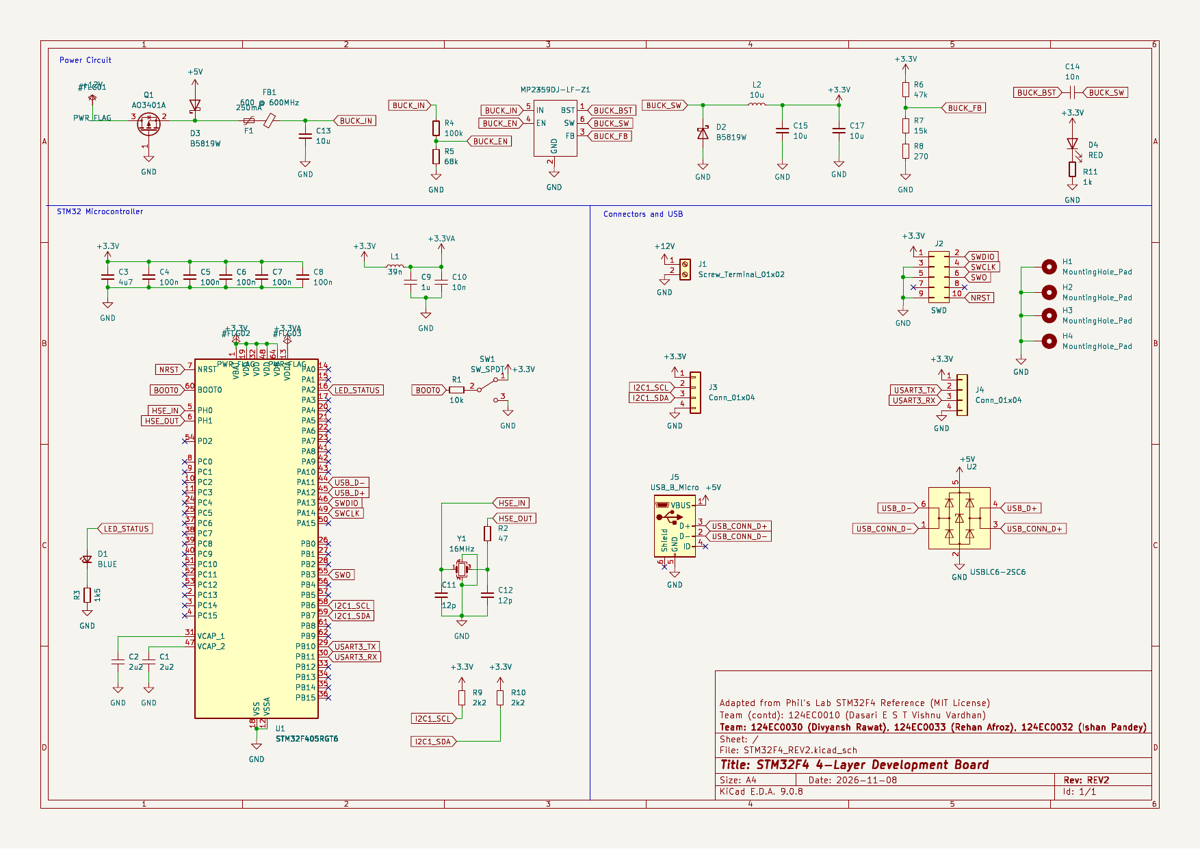
CIRCUIT DIAGRAM
Schematic (current repository)
manufacturing/STM32F4_REV2_schematic.pdf · KiCad 9.0.8 plot, 8 Nov 2026. Title block corrected: Divyansh Rawat = 124EC0030, Rehan Afroz = 124EC0033, Ishan Pandey = 124EC0032, Dasari E S T Vishnu Vardhan = 124EC0010.

Slide 6
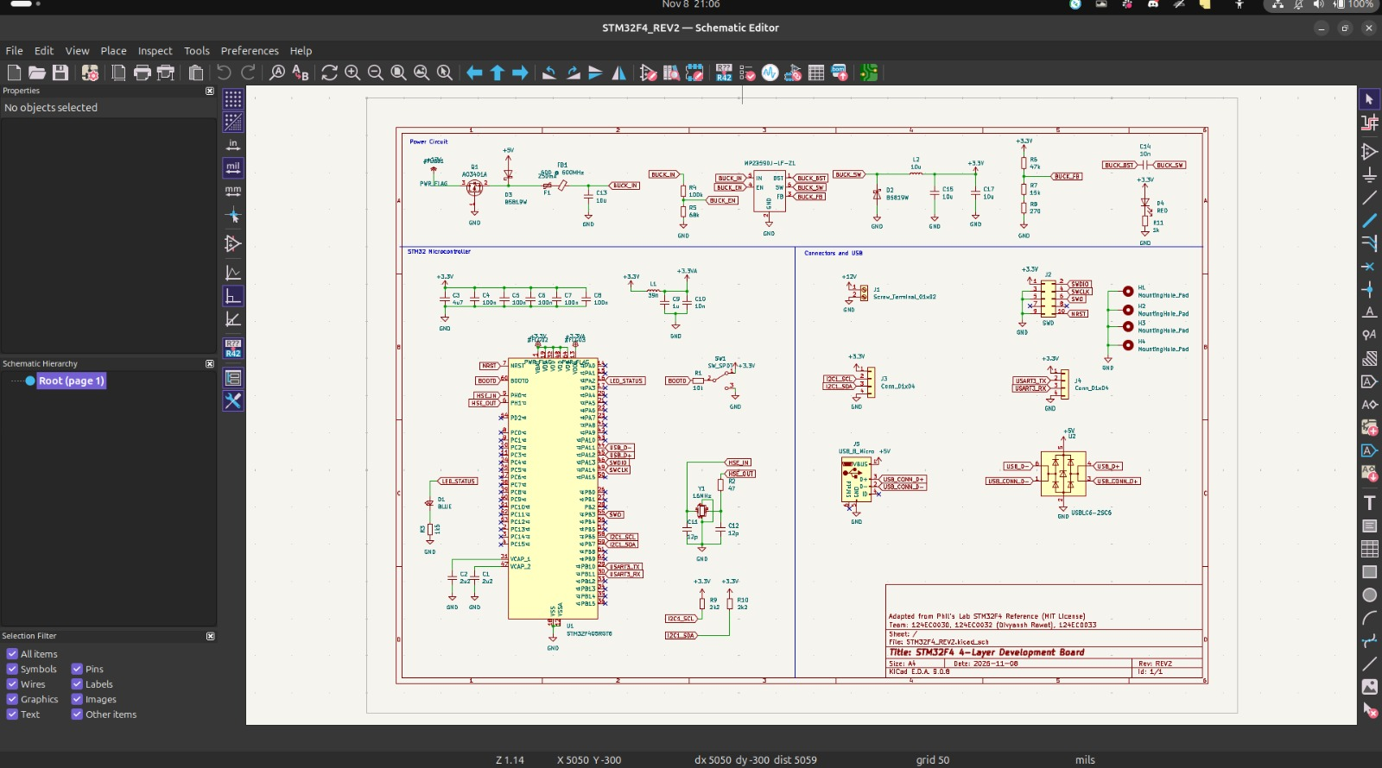
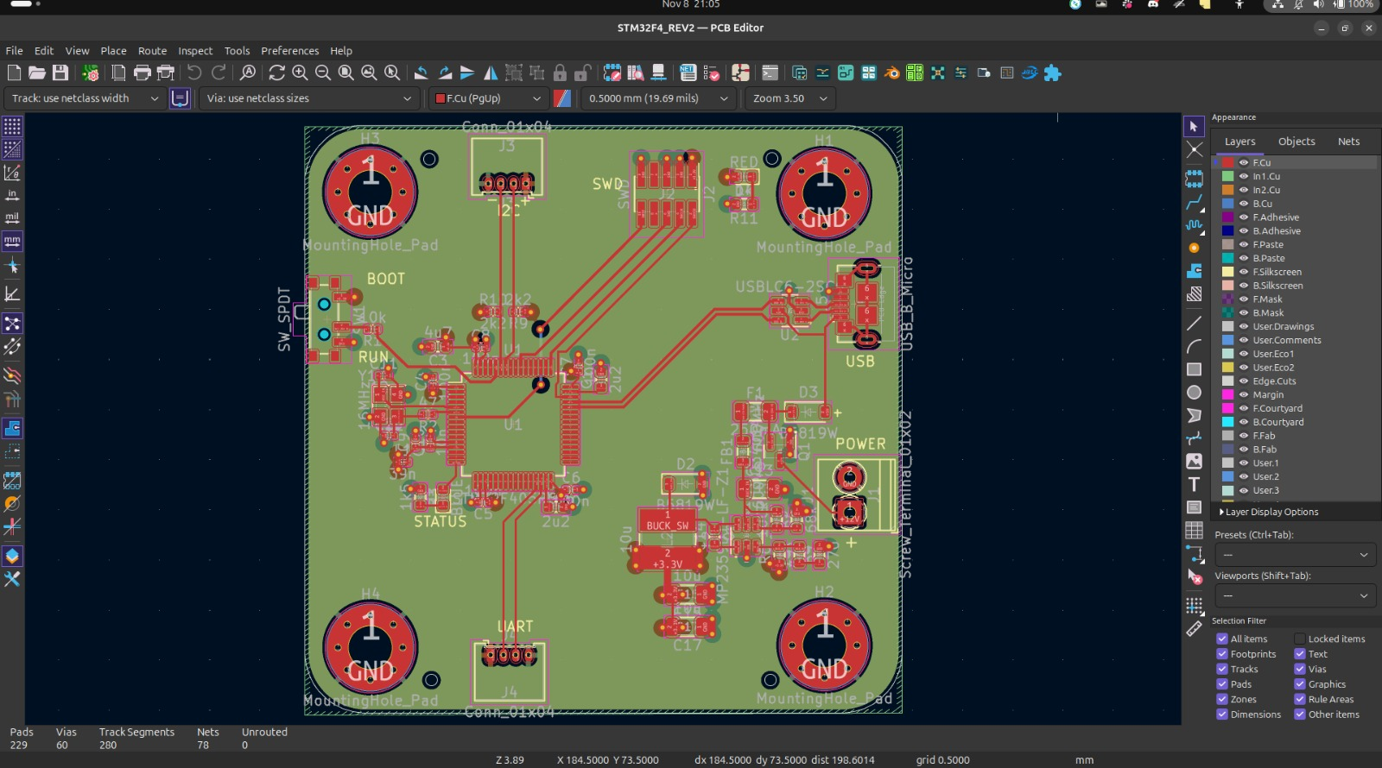
LAYOUT
Working views in KiCad 9
Schematic Editor — the full sheet in the working project
PCB Editor — routed board; status bar shows Unrouted: 0
Screenshots from the team's KiCad 9.0.8 session, 8 Nov 2026.

Slide 7
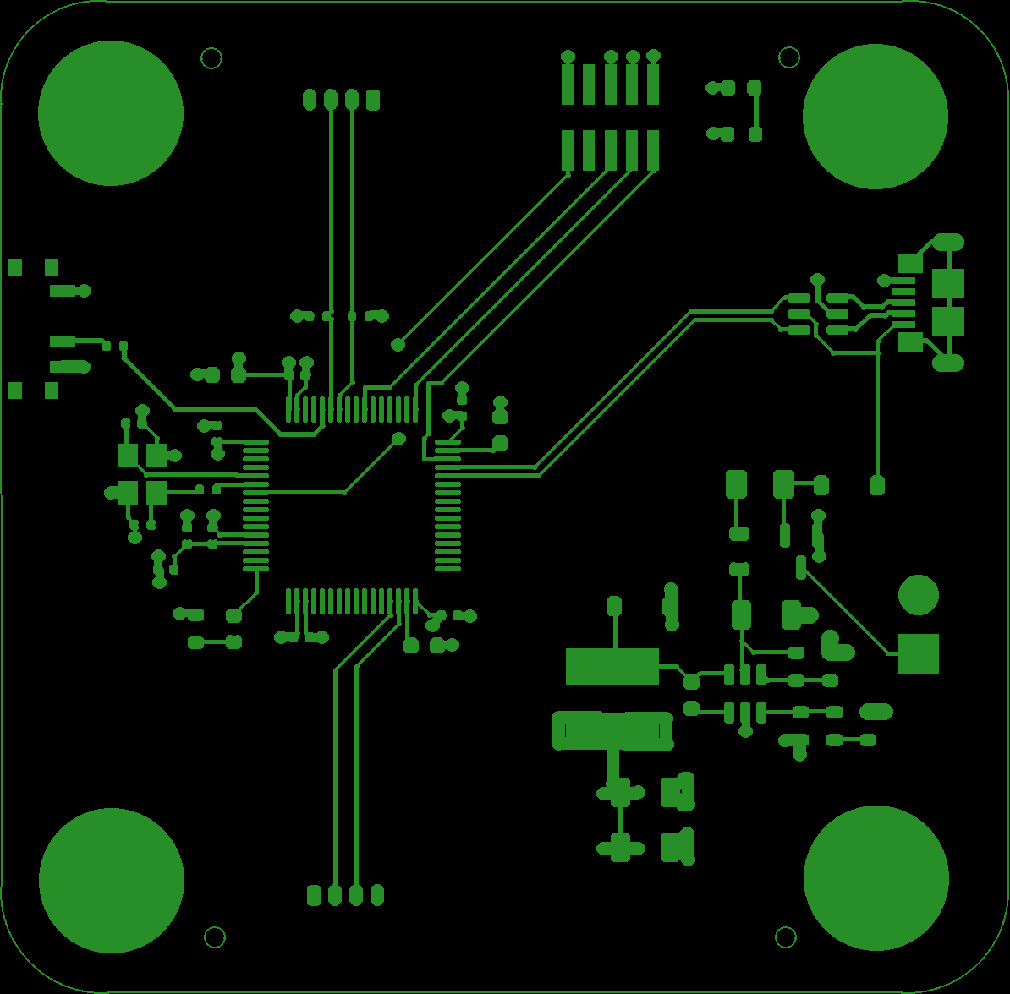
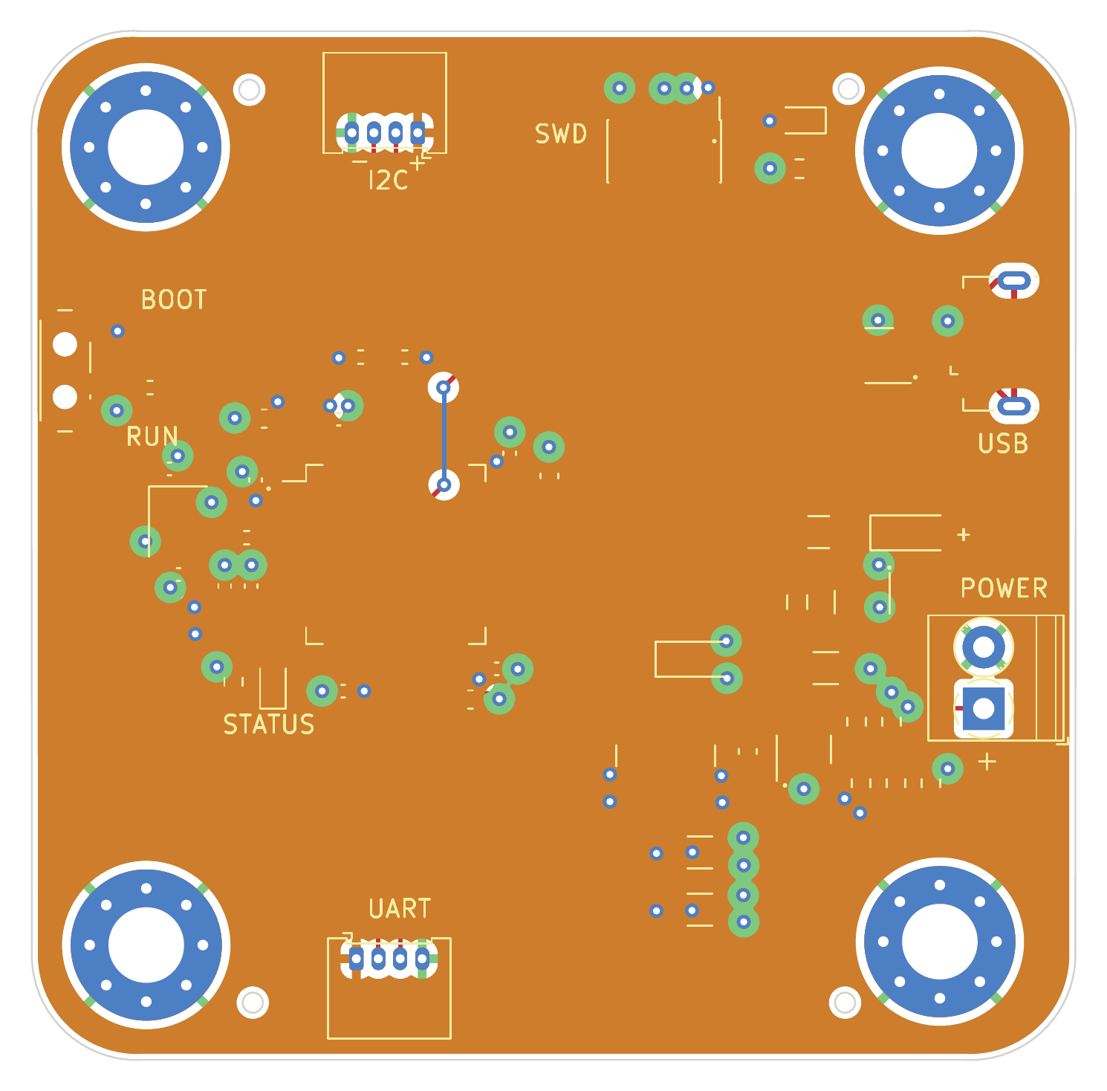
LAYOUT
PCB layout
Top copper (F.Cu): tracks and pads
Rendered from the actual manufacturing Gerber (STM32F4_REV2-F_Cu.gtl) + board outline
All copper layers overlaid
KiCad PCBNEW plot (manufacturing/STM32F4_REV2.pdf)

Slide 8
LAYOUT
4-layer stackup & layout strategy
STACKUP
L1 · F.Cu Components + high-speed signals
L2 · In1.Cu Solid ground plane (0 V reference)
L3 · In2.Cu Solid +3.3 V power plane
L4 · B.Cu Remaining signals (no copper pour)
SIGNAL & POWER INTEGRITY INTENT
• Decoupling: every VDD pin gets a 100 nF bypass capacitor placed next to the pin; VDDA has its own filter; the VCAP pins carry the datasheet-required 2.2 µF each (C1, C2).
• Return paths: top-layer high-speed traces are routed over the solid L2 ground plane as their intended return reference.
• Hot loop: buck switch node, catch diode and inductor sit close together, intending a small 1.4 MHz hot loop.
• USB pair: USB D+/D− routed as a short, side-by-side pair over the ground plane.
Stackup verified against the board file: 4 copper layers; copper pours exist only on In1.Cu (GND) and In2.Cu (+3.3V).

Slide 9
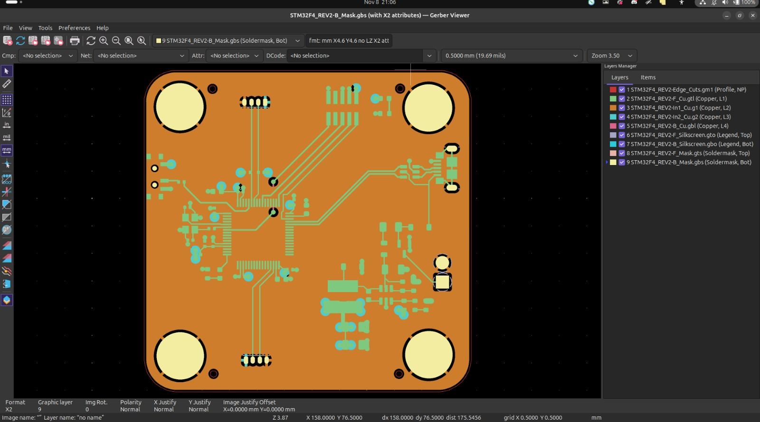
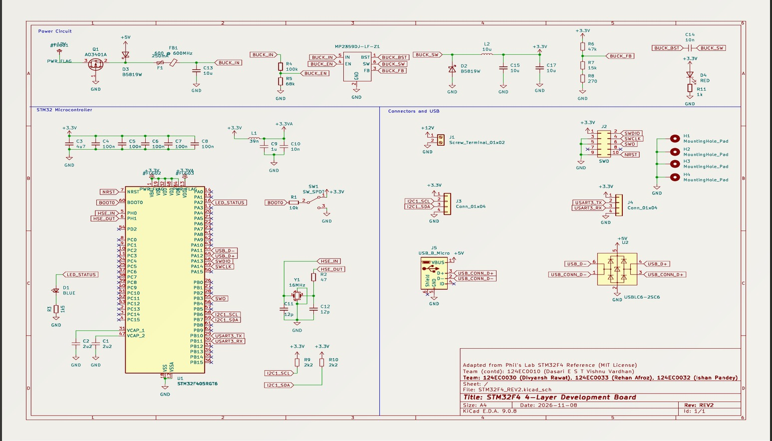
MANUFACTURING DATA
Exported design data
Gerber Viewer — Layers Manager lists all four copper layers
Schematic sheet as plotted from KiCad
Screenshots from the team's KiCad 9.0.8 session, 8 Nov 2026.

Slide 10
CIRCUIT DESIGN
16 MHz oscillator design (ST AN2867)
CRYSTAL & LOADS
• Crystal Y1: 16.000 MHz, load capacitance C_L = 9 pF, ESR ≤ 50 Ω (JLCPCB C13738)
• Load capacitors: C11 = C12 = 12 pF → 6 pF in series
• Strays: ≈ 3 pF of stray capacitance assumed (AN2867 typical estimate 2–3 pF)
GAIN MARGIN
• AN2867: g_mcrit = 4 · ESR · (2πf)² · (C0 + C_L)² ≈ 0.25 mA/V, with assumed C0 = 2 pF
• MCU: STM32F4 HSE oscillator gm(min) = 5 mA/V (AN2867 Table 6)
• Margin: ≈ 20×, above the AN2867 minimum of 5×
Method per ST AN2867, Oscillator design guide for STM32 MCUs; margin computed with the stated inputs.

Slide 11
VERIFICATION
Design-file checks, re-run and saved
Check | How it was run | Result | Status
Schematic ERC | kicad-cli sch erc --severity-all | 0 errors, 0 warnings, 0 violations | PASS
Board DRC | kicad-cli pcb drc --severity-all | 0 violations | PASS
Unconnected items | same DRC run | 0 unconnected pads | PASS
Schematic–PCB parity | kicad-cli pcb drc --schematic-parity | 0 discrepancies | PASS
Power planes | zone refill + DRC (GUI) | In1 GND and In2 +3.3V pour clean | PASS
BOM vs position data | bom.csv reconciled against pos.csv | 46 SMD parts match; H1–H4 mounting holes excluded by design; no DNP, no value mismatches | PASS
Gerber re-export | kicad-cli pcb export gerbers + drill | 34-file set identical to the manufacturing gerbers.zip (4 copper, mask, paste, silkscreen, outline, drill) | PASS
Re-run by the team on 8 Nov 2026, 01:55 IST, KiCad 9.0.8. Reports saved under verification/ (erc-rerun.json, drc-rerun.json, gerbers-check/).
Software checks of the design files; no hardware was fabricated or tested.

Slide 12
DELIVERABLES
Submission package
CONTENTS · “STM32F4 4-Layer Development Board”
• Native design files: STM32F4_REV2.kicad_sch / .kicad_pcb / .kicad_pro / .kicad_sym (KiCad 9 sources)
• manufacturing/: gerbers.zip (4-layer Gerbers + drill), bom.csv, pos.csv, schematic & layout PDFs, 3D render
• Session screenshots: the team's 3 KiCad 9 working views (Schematic Editor, PCB Editor, Gerber Viewer)
• Docs: Design Considerations document (includes the MIT attribution) and this presentation
PROVENANCE
Adapted and re-routed from the open-source STM32F4 Reference Design by Philip Salmony (Phil's Lab), used under the MIT License. Attribution is retained in the Design Considerations document and in the KiCad title block.
8 November 2026 · Team 124EC0030 / 124EC0032 / 124EC0033 / 124EC0010

